Slide 1

Bootstrapping Spectral Density
Uyen Le

Slide 2
Content
Motivation
Algorithm
spec.boots
Applications

Slide 3
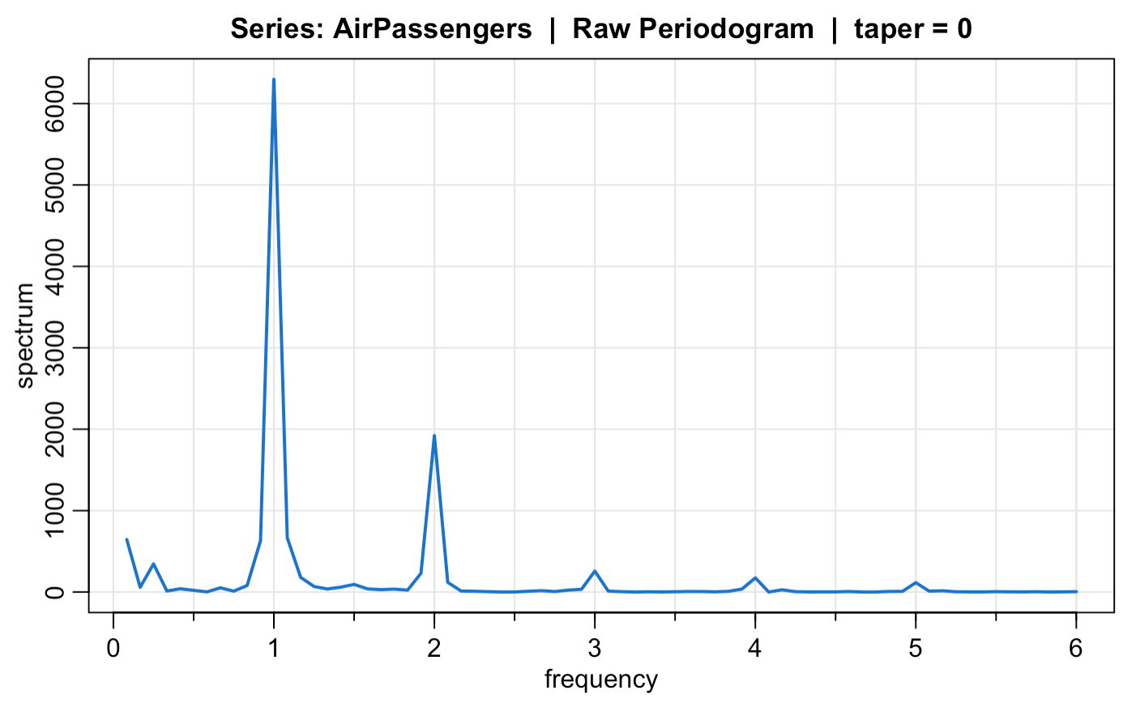
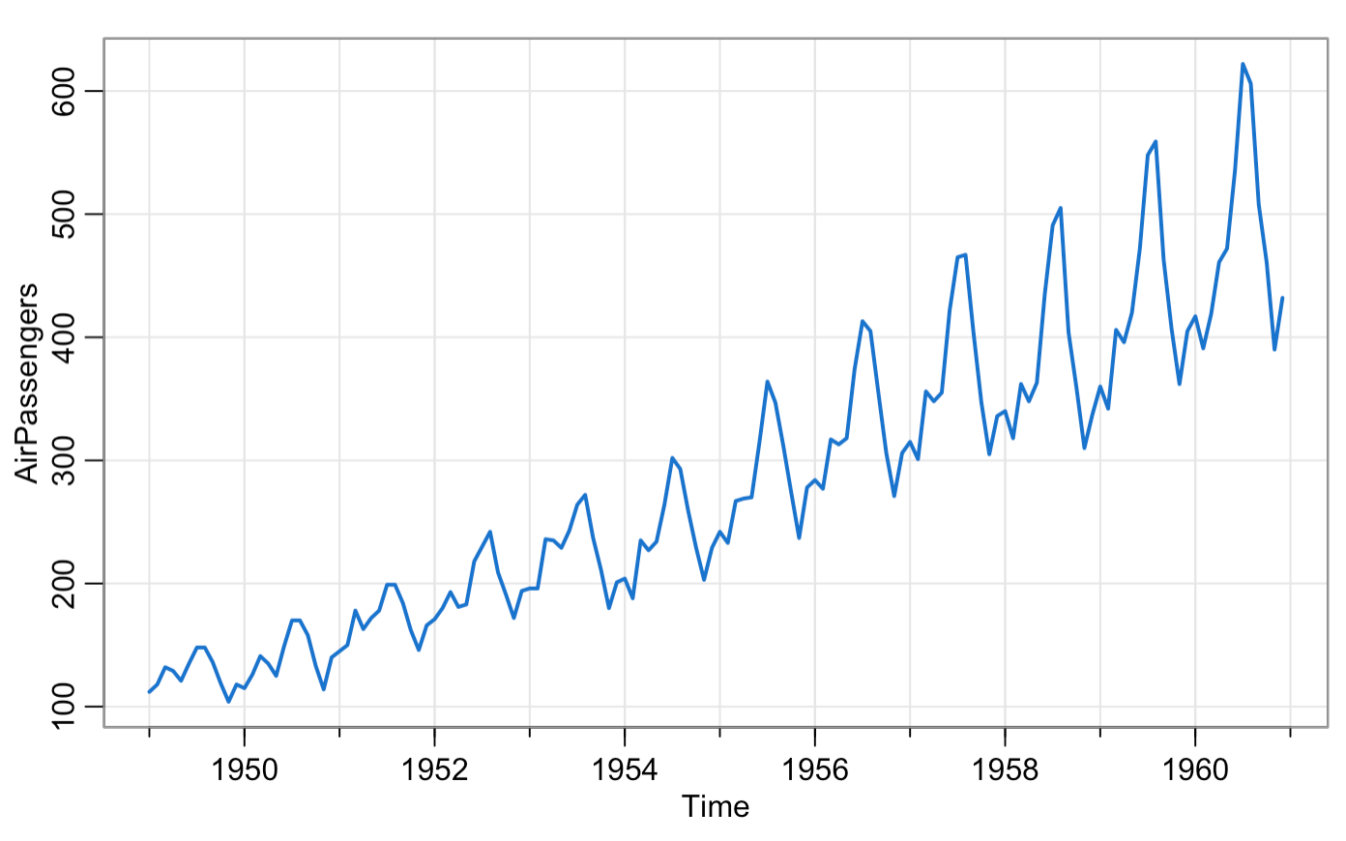
Motivation
Notes:
AirPassengers data, periodic pattern annually
Scaled periodogram → rough sample estimate of the population spectral density, give us an idea of the variance components associated with each freq
Large values of the periodogram indicate which frequencies are predominant in the ts
What important: The spectral density

Slide 4
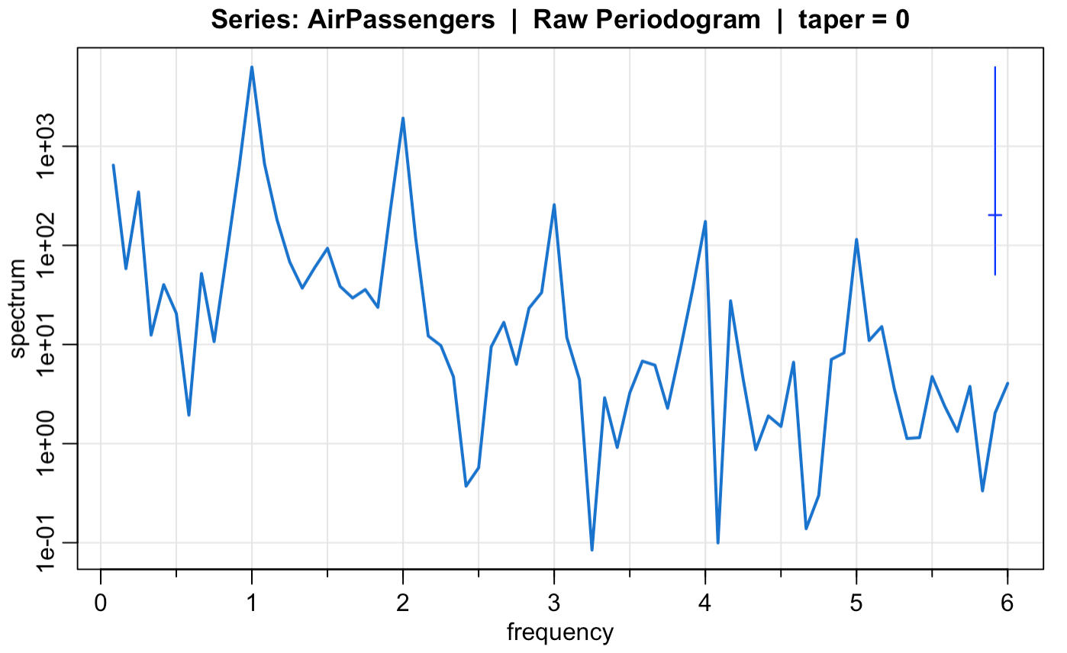
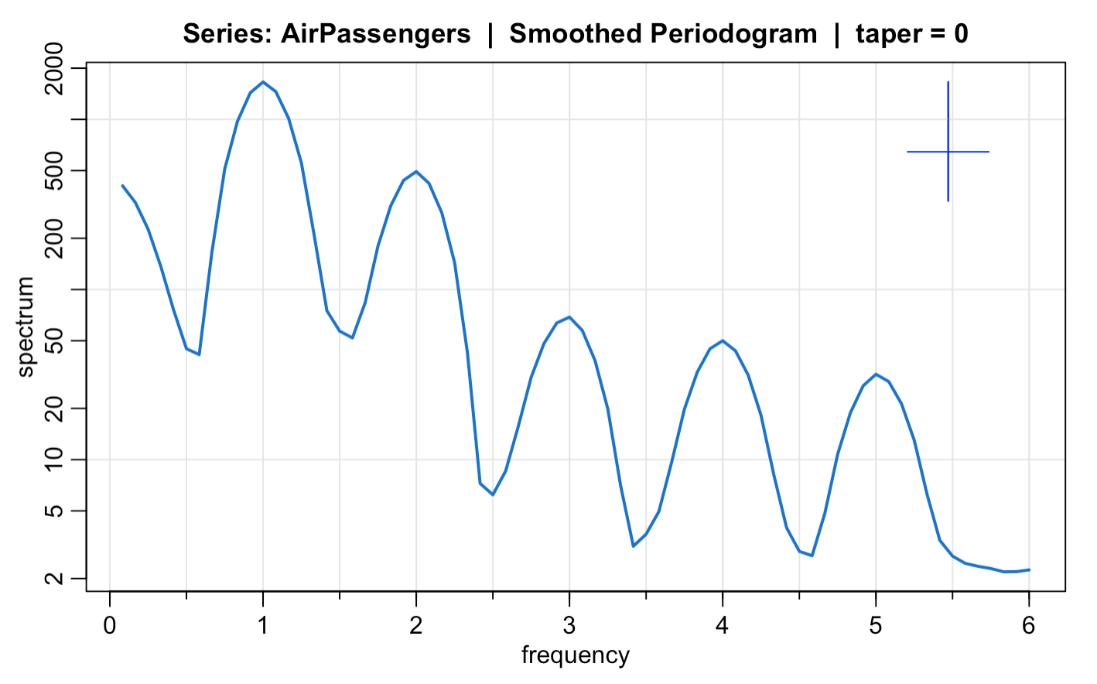
Periodogram and Spectral Density
Notes:
The spectral density → population level, the periodogram is a sample version
The variance of the periodogram does not change as n gets large → the periodogram never gets close to the spectrum
However, we can construct a confidence interval for the spectral density based on the periodogram assuming chi-sq distribution with 2 degrees of freedom
Function: mvspec → log → produce a generic interval that is too wide to be of much use
Nonparametric Estimation: reduce the variability
Problem: an undesirable effect of averaging: the peaks are flattened and spread out to nearby frequencies

Slide 5
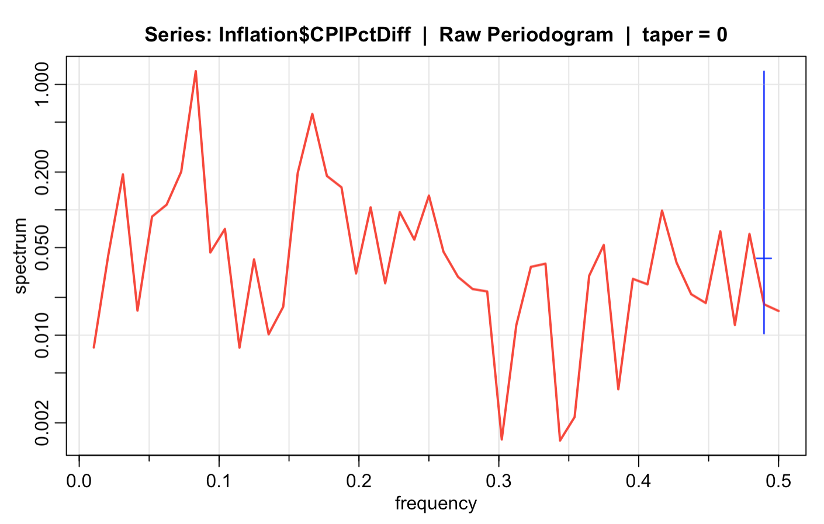
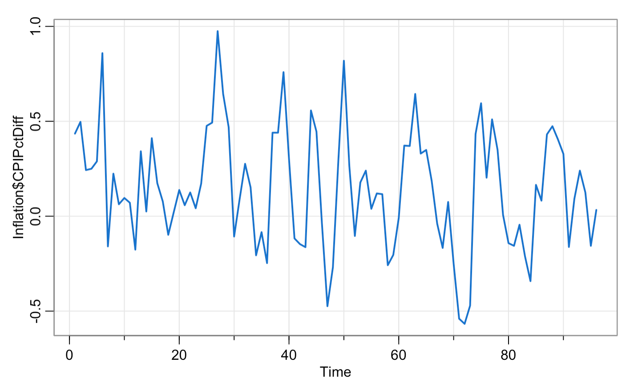
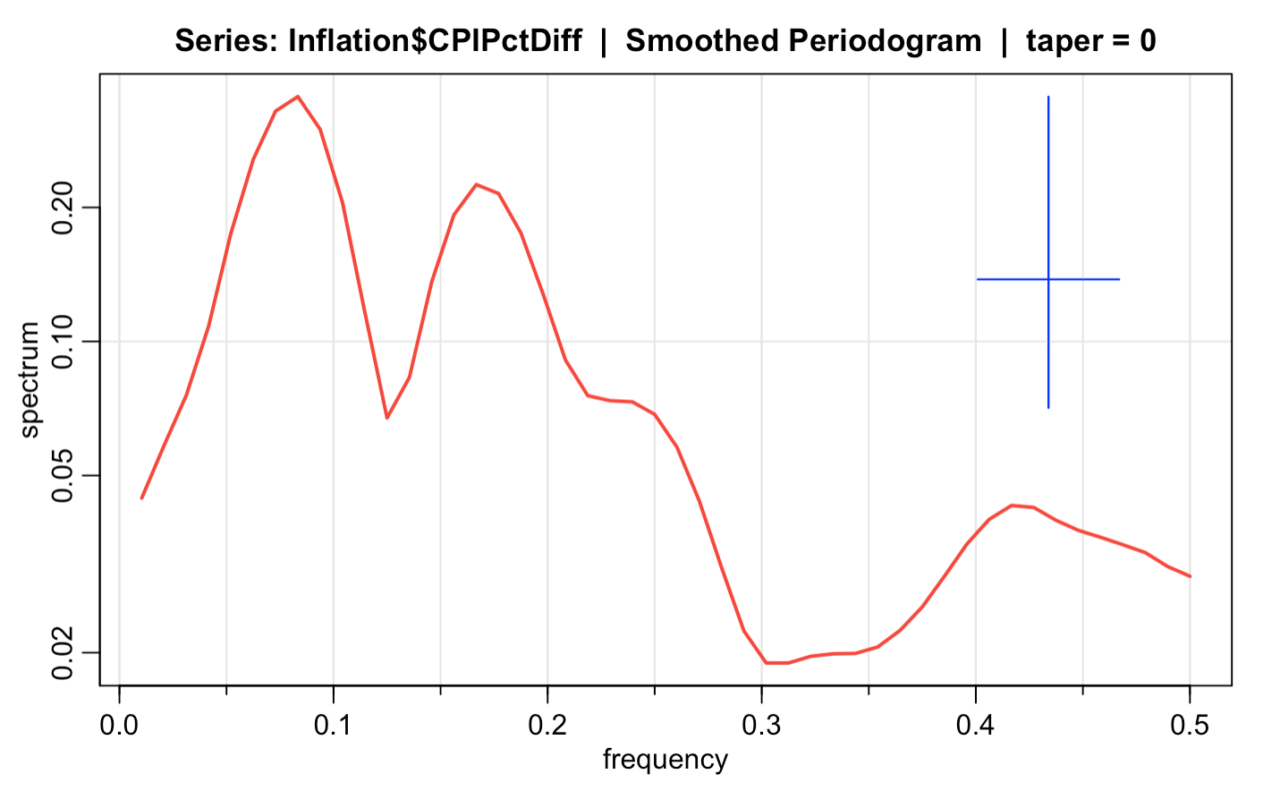
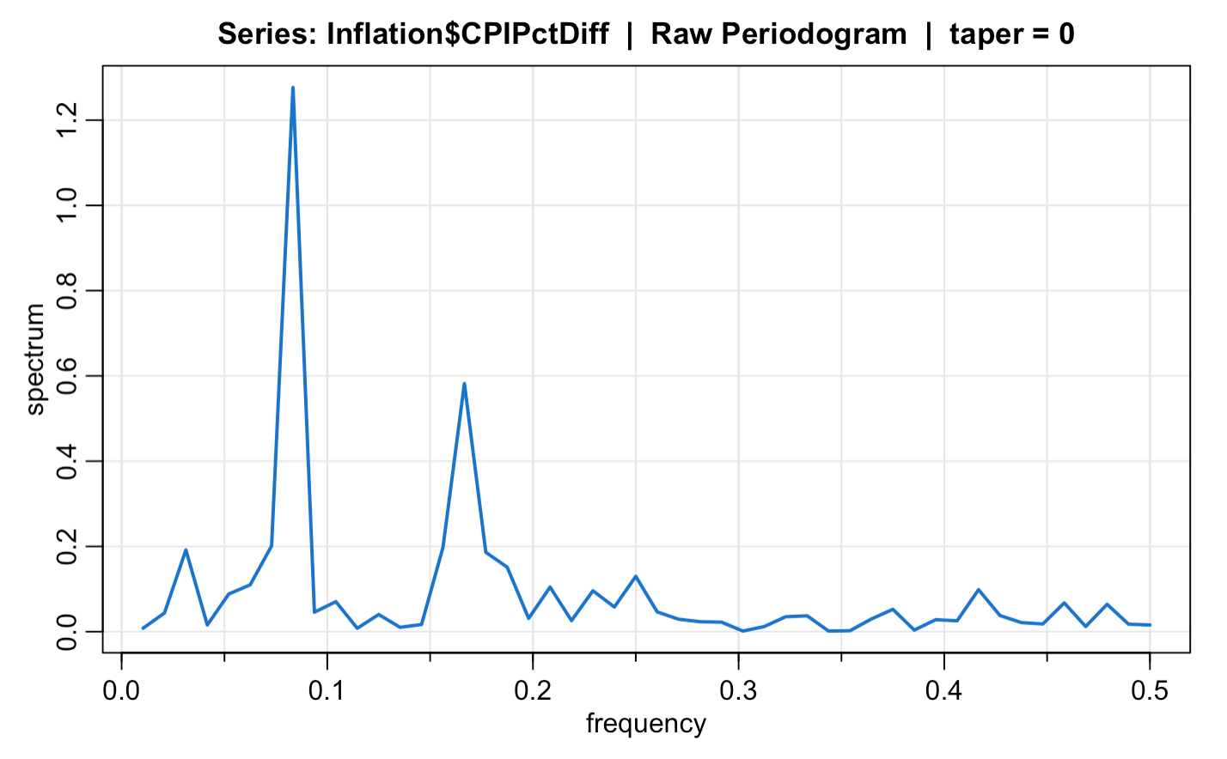
Notes:
CPI returns, not a clear pattern
Problem:
Sometimes we still end up with a wide confidence interval

Slide 6

Solution BOOTSTRAPPING

Slide 7
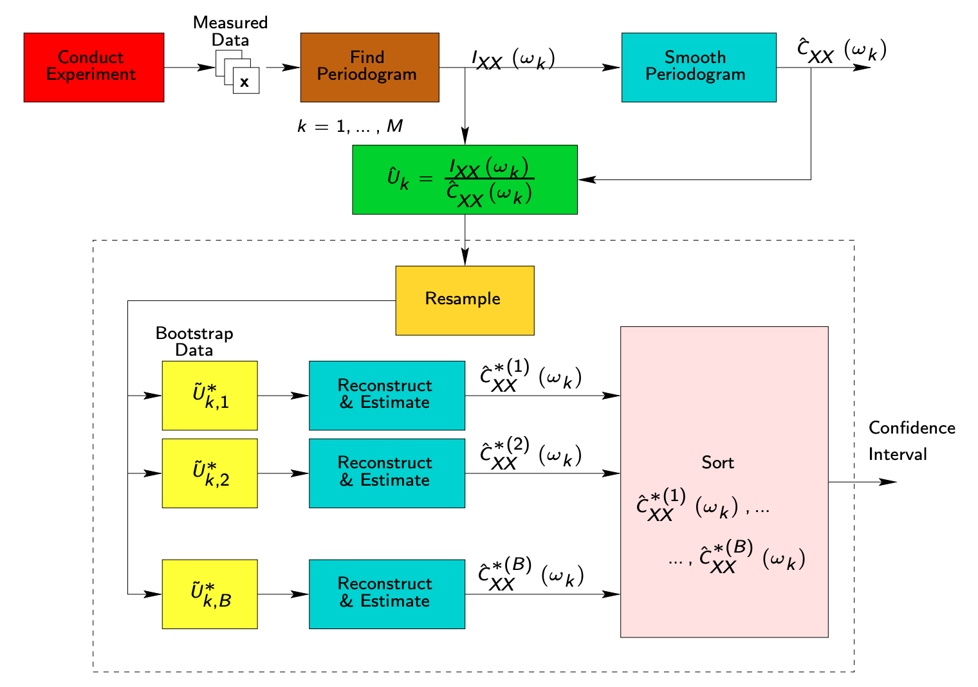
Zoubir, Abdelhak M.. 2010.

Slide 8
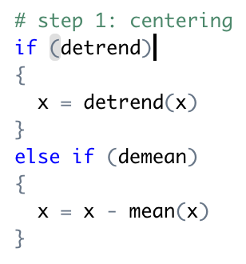
Step 1: Centering
Subtract the sample mean
from the data.
Notes:
Nonstationarry trends are present should be eliminated before computing the periodogram. Trends introduce extremely low freqeucny components in the periodogram that tend to obscure the apperance at higher freqs. → Center the data prior to a spectral analysis

Slide 9
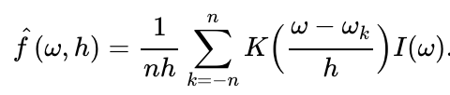
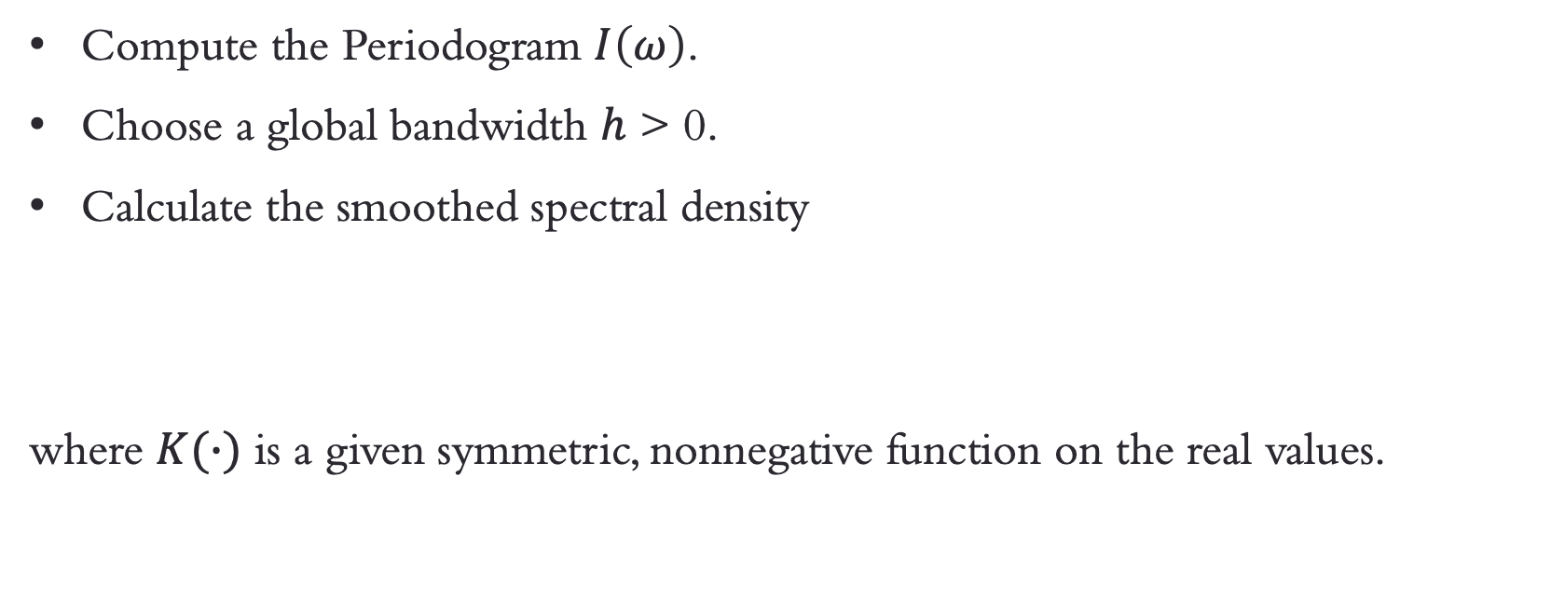
Step 2: Initial Estimate
Compute the Periodogram $I\left(ω\right)$.
Choose a global bandwidth $h$ > 0.
Calculate the smoothed spectral density
where $K(∙)$ is a given symmetric, nonnegative function on the real values.
Notes:
h does not depend on w

Slide 10
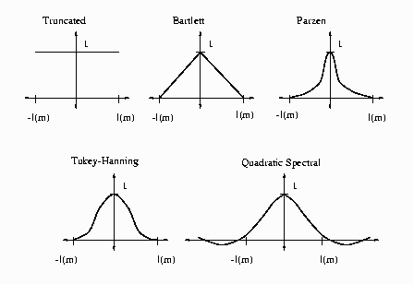
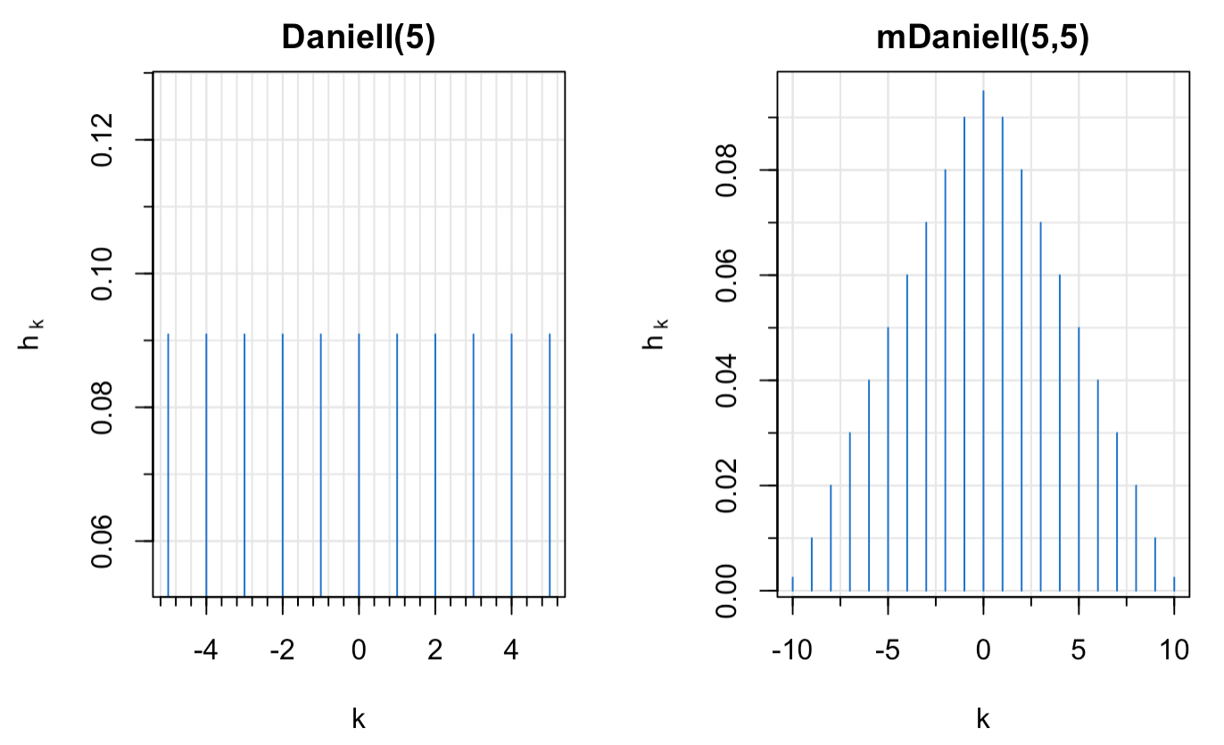
Kernel Weights
Daniell Weights

Slide 11
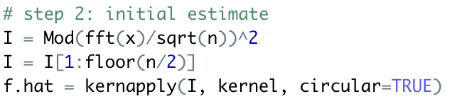
Notes:
h does not depend on w

Slide 12
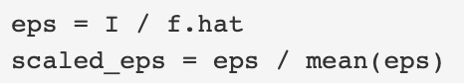
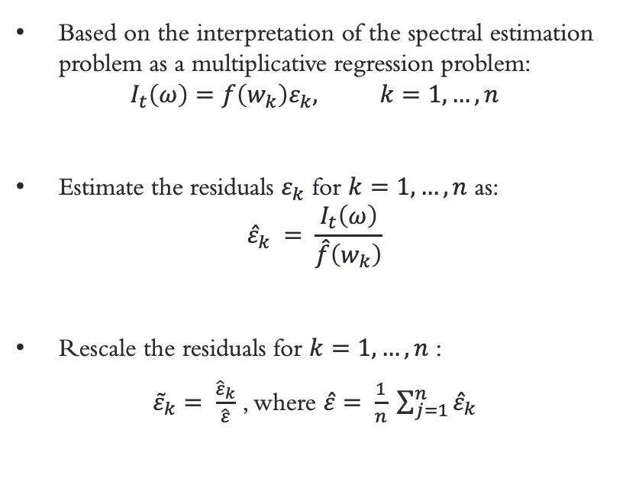
Step 3: Compute and Rescale the Residuals
Based on the interpretation of the spectral estimation problem as a multiplicative regression problem:
$$I_{t}\left(ω\right)=f\left(w_{k}\right)ε_{k}, k=1, …, n$$
Estimate the residuals $ε_{k}$ for $k=1, …, n$ as:
$${\hat{ε}}_{k} = \frac{I_{t}\left(ω\right)}{\hat{f}\left(w_{k}\right)}$$
Rescale the residuals for $k=1, …, n$ :
${\tilde{ε}}_{k}= \frac{{\hat{ε}}_{k}}{\hat{ε}}$ , where $\hat{ε}= \frac{1}{n} \sum_{j=1}^{n}{{\hat{ε}}_{k}}$
Notes:
Multiplicative models are used primarily for testing inferences about the effects of various predictor variables and their interactions on the response variable in much the same way as factorial ANOVA.
The residuals are approximately independent and identically distributed for large n.
The rescaling of residuals performed in Step 3 serves essentially the same purpose as re-centering the data in an additive regression model in order to avoid an additional bias at the resampling stage.

Slide 13
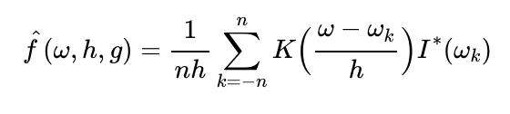
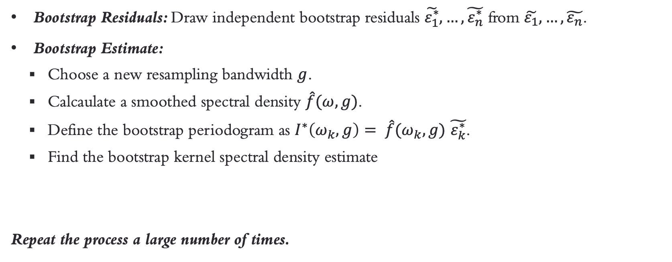
Step 4 – 6: Bootstrap Residuals and Estimate
Bootstrap Residuals: Draw independent bootstrap residuals $\tilde{ε_{1}^{∗}}, …,\tilde{ε_{n}^{∗}}$ from $\tilde{ε_{1}}, …,\tilde{ε_{n}}$.
Bootstrap Estimate:
Choose a new resampling bandwidth $g$.
Calcaulate a smoothed spectral density $\hat{f}(ω, g)$.
Define the bootstrap periodogram as $I^{∗}\left(ω_{k},g\right)= \hat{f}(ω_{k}, g)$ $\tilde{ε_{k}^{∗}}$.
Find the bootstrap kernel spectral density estimate
Repeat the process a large number of times.

Slide 14
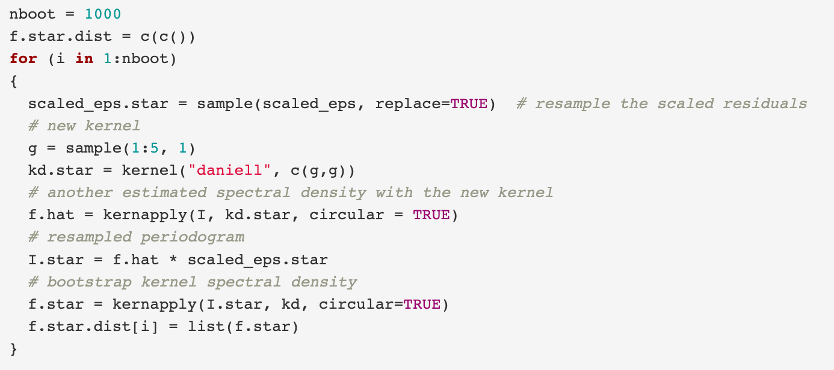
Step 4 – 6: Bootstrap Residuals and Estimate

Slide 15
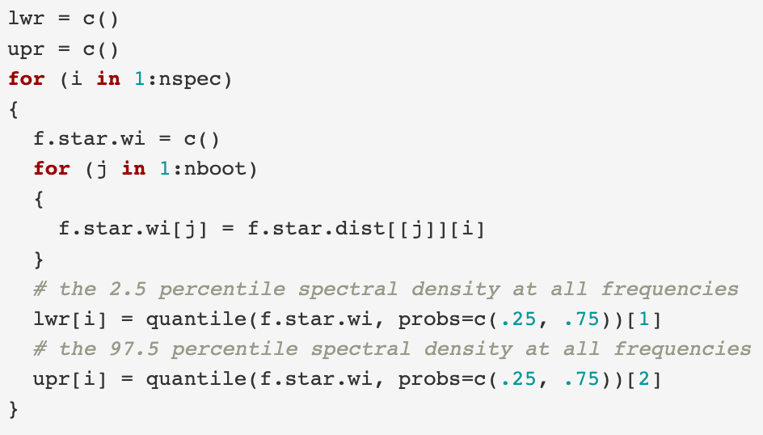
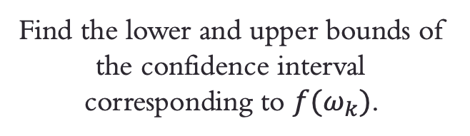
Step 7: Confidence Interval Estimation
Find the lower and upper bounds of the confidence interval corresponding to $f(ω_{k})$.

Slide 16
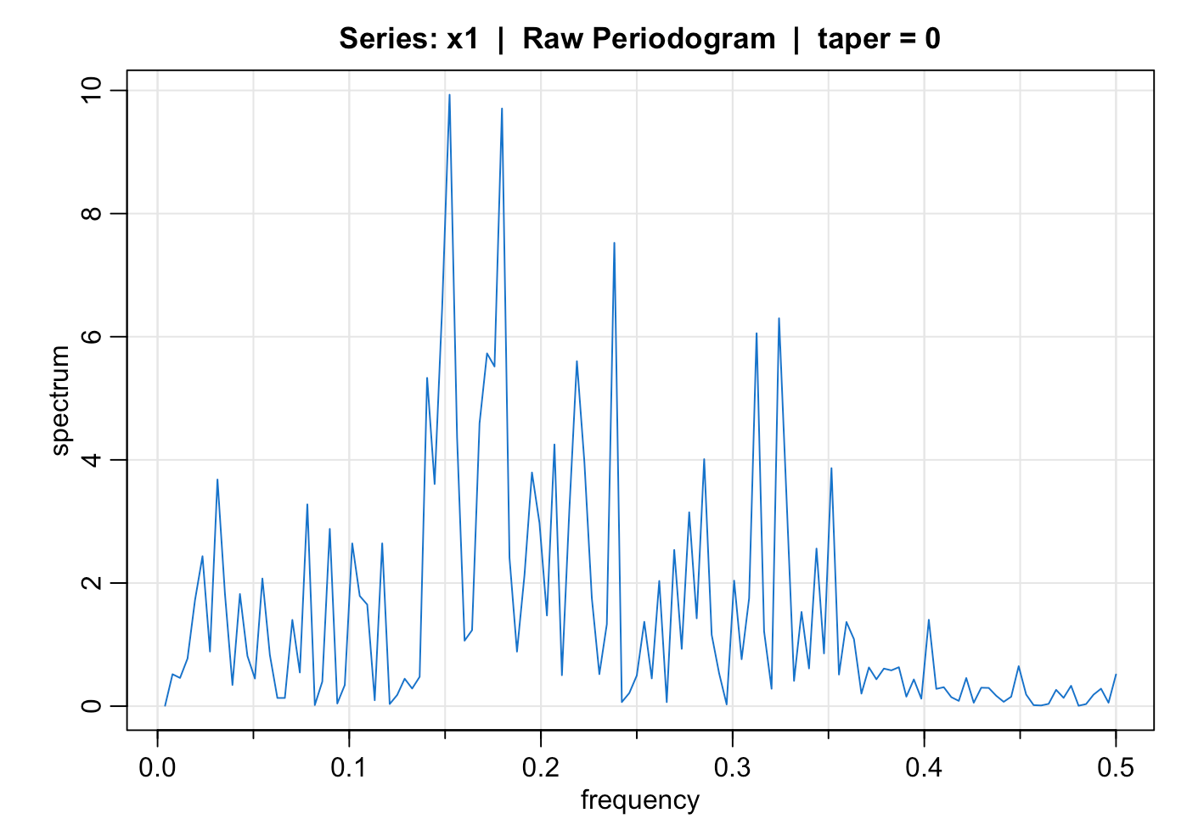
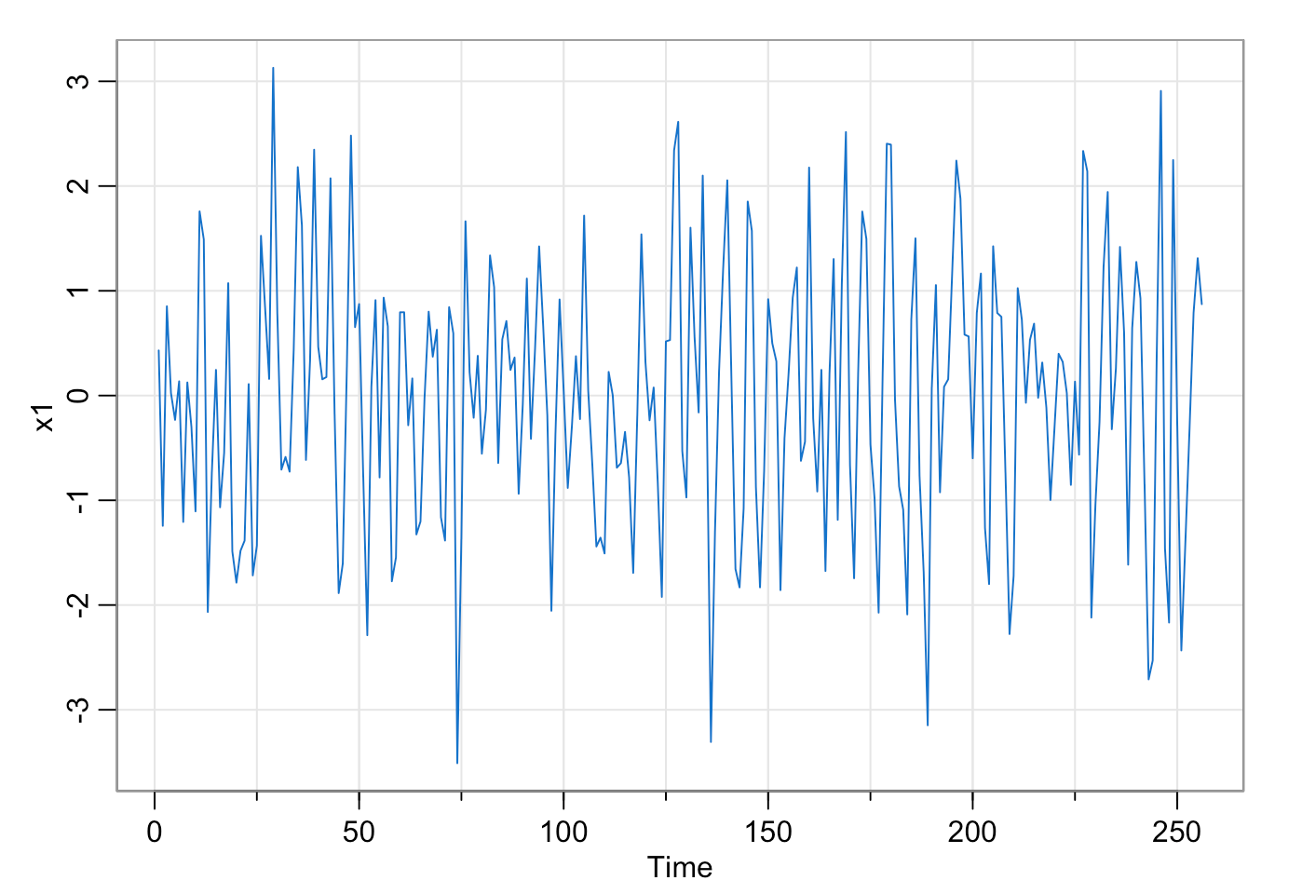
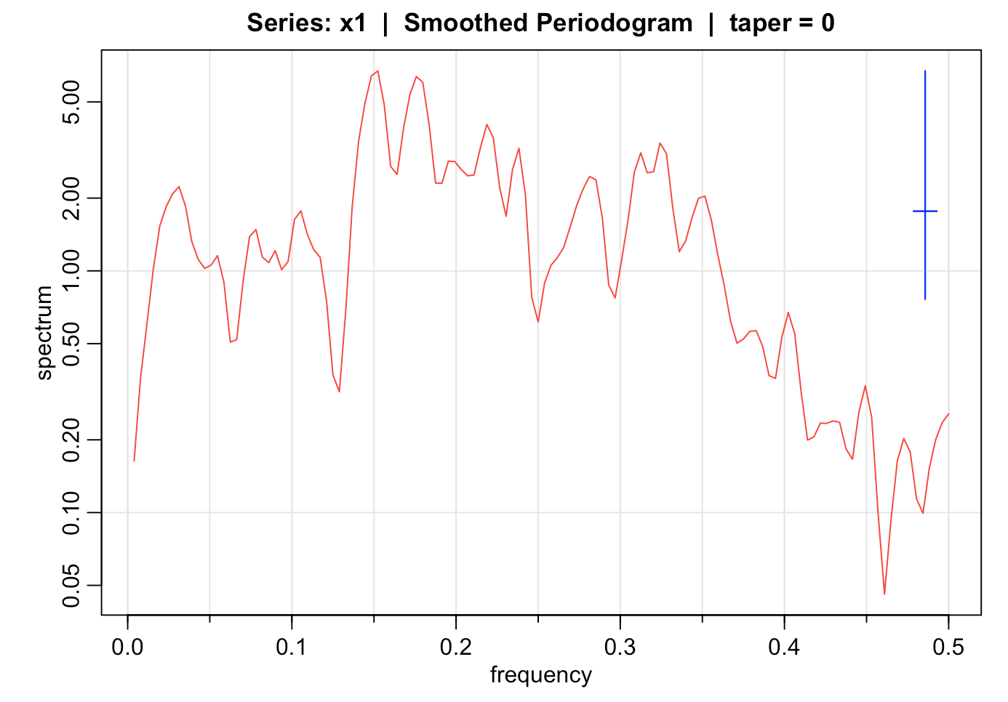
Simulation

Slide 17
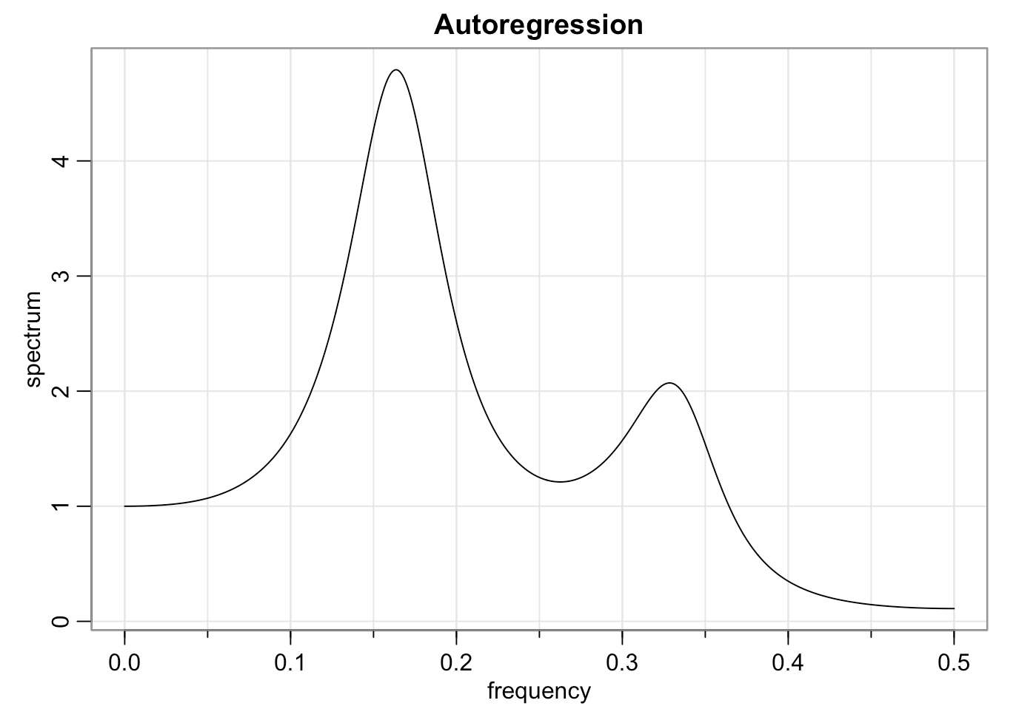
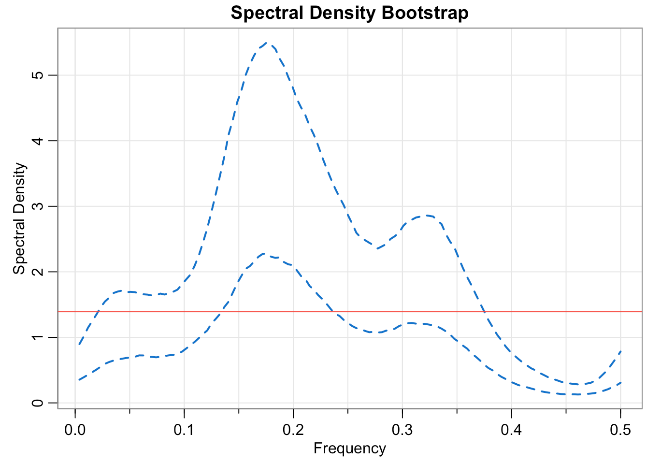
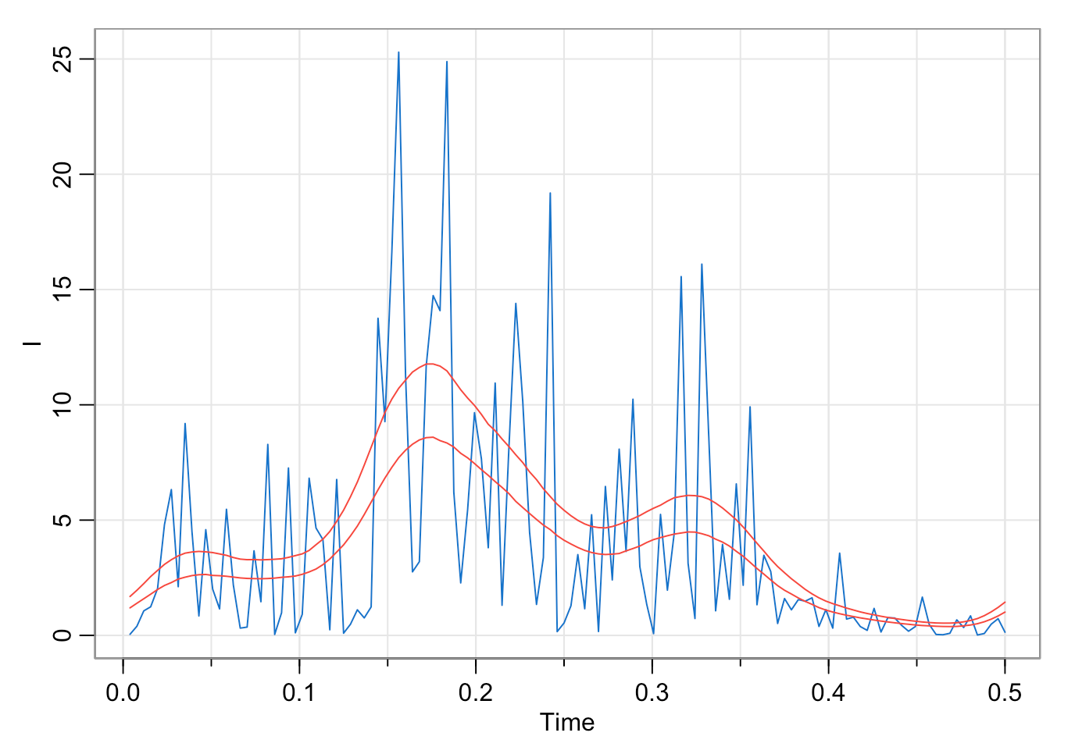

Slide 18

spec.boots: Bootstrapping Spectral Density

Slide 19
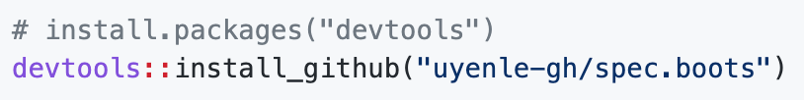
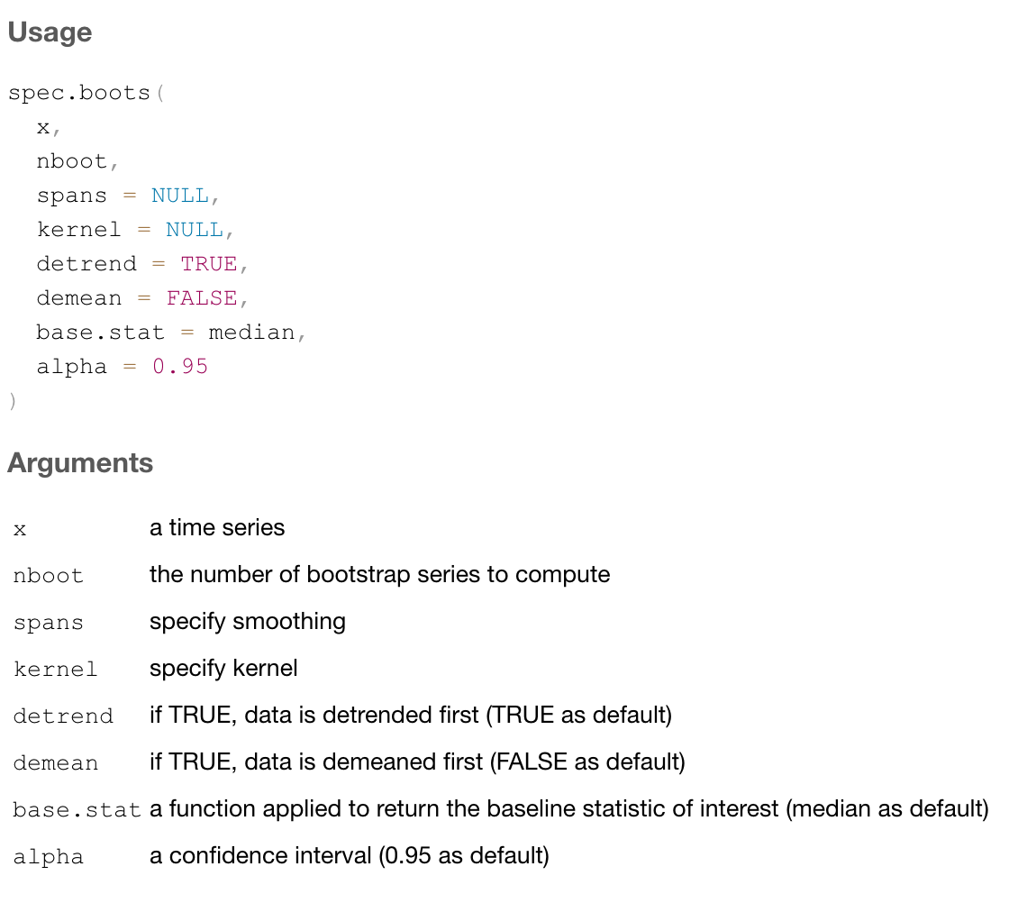
How to use spec.boots?

Slide 20
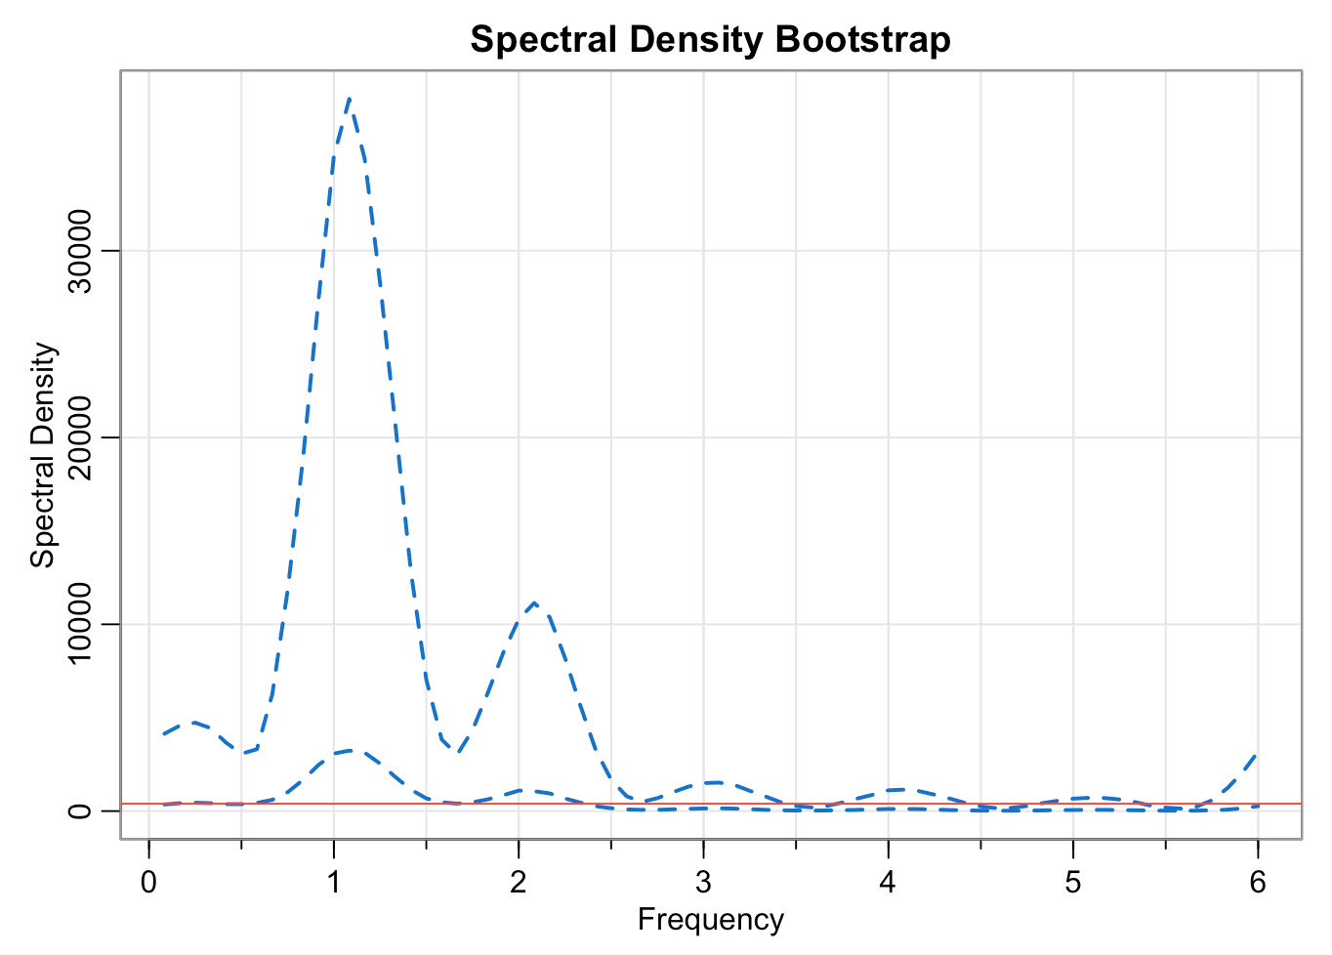

Slide 21
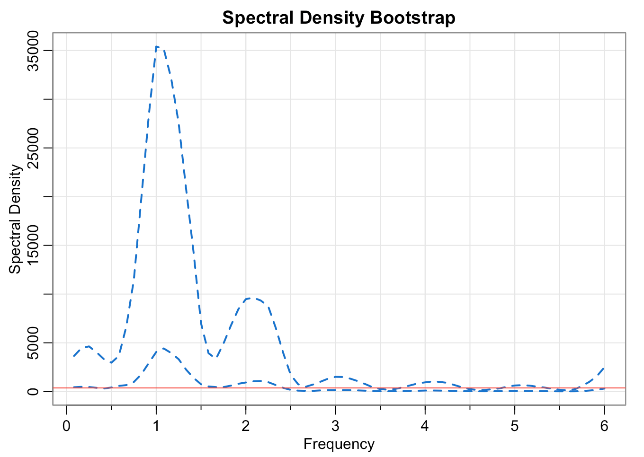
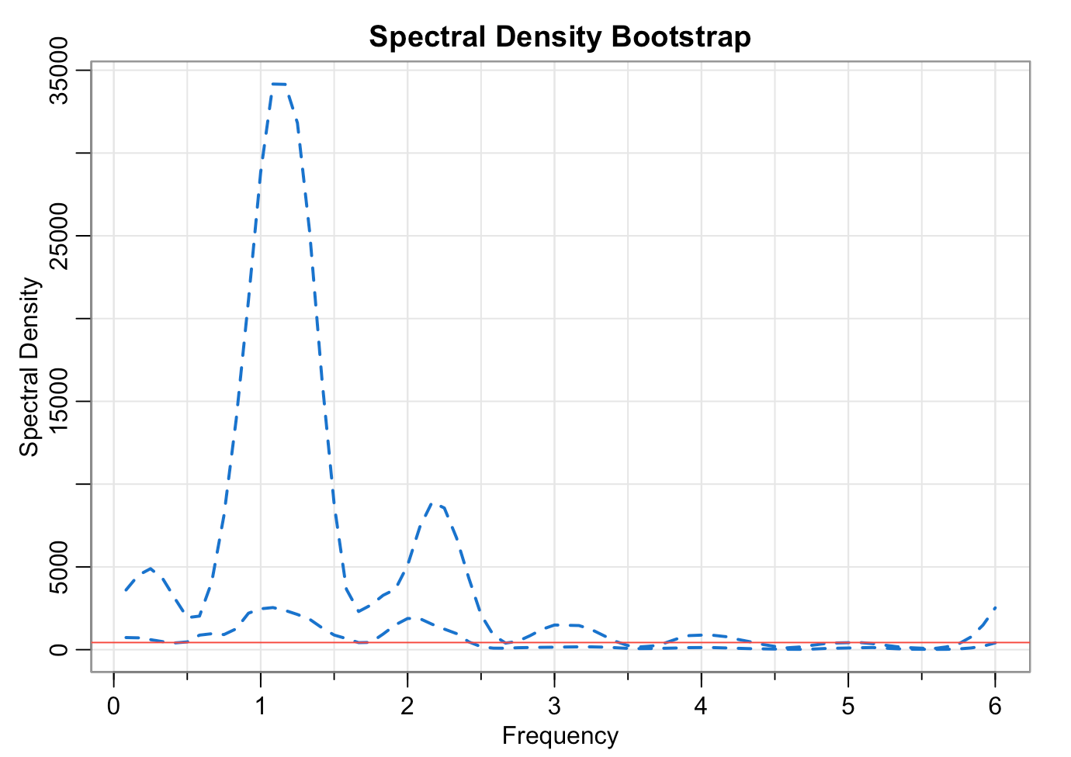
Different numbers of bootstrap samples
nboot = 10
nboot = 100
nboot = 1000

Slide 22
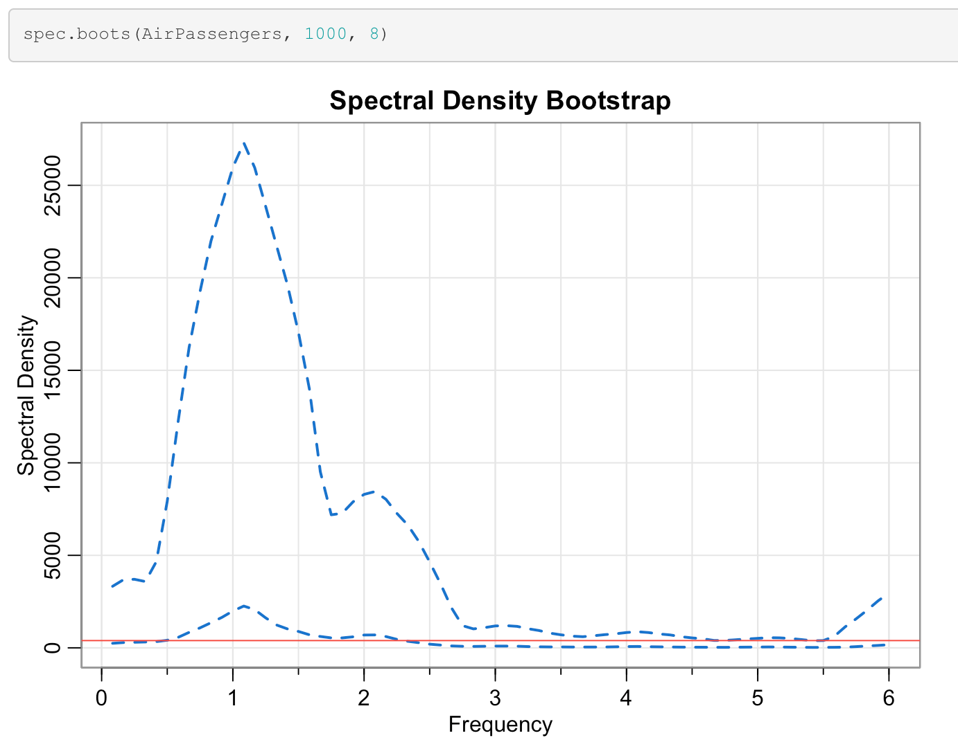
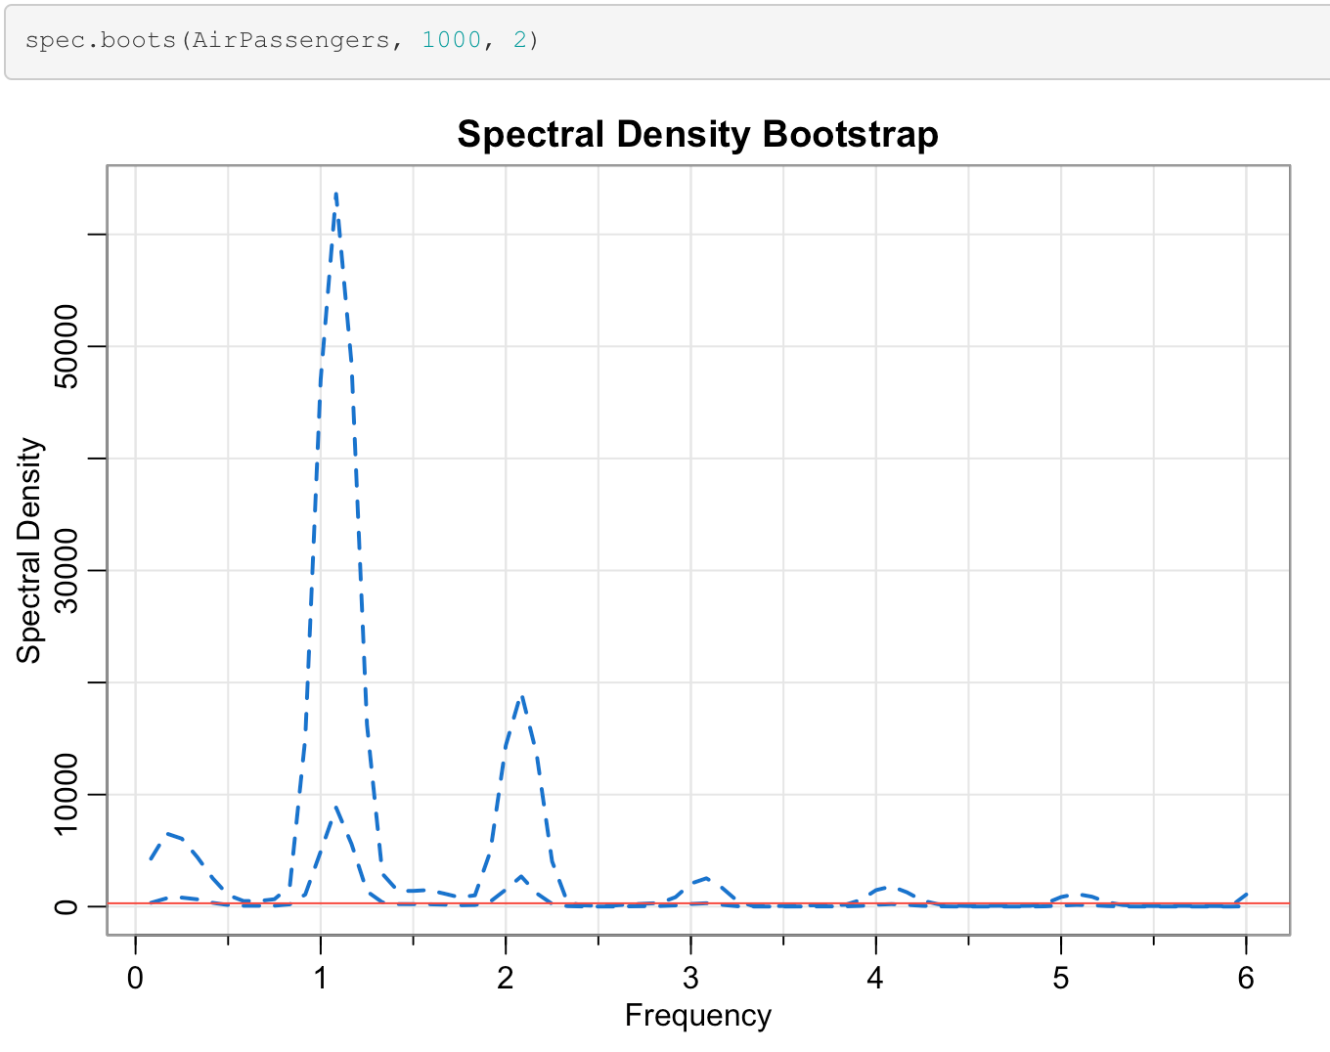
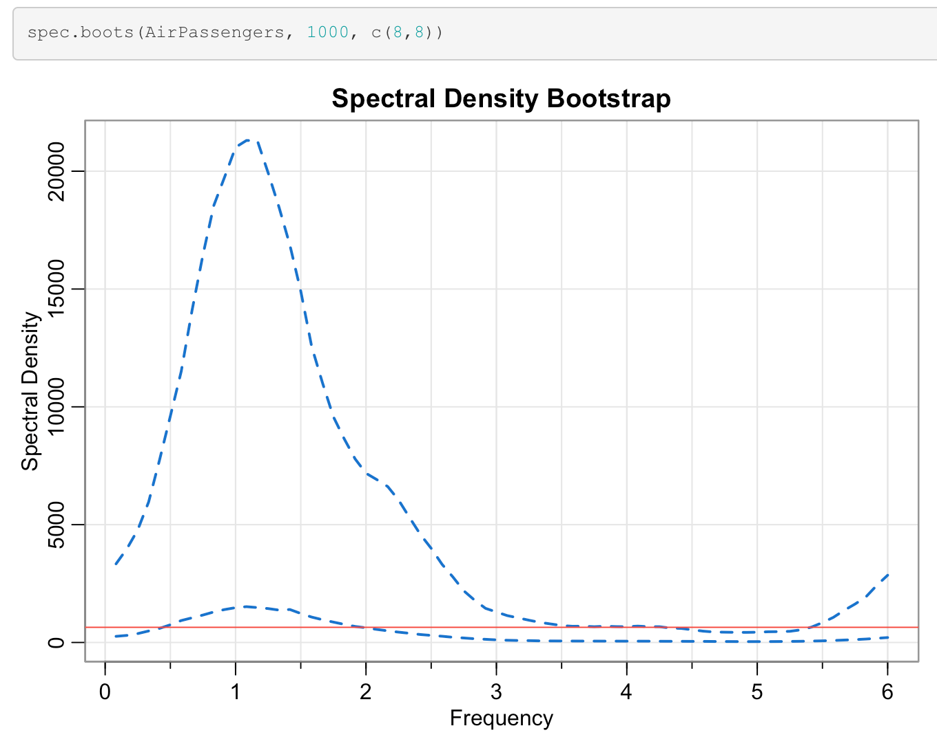
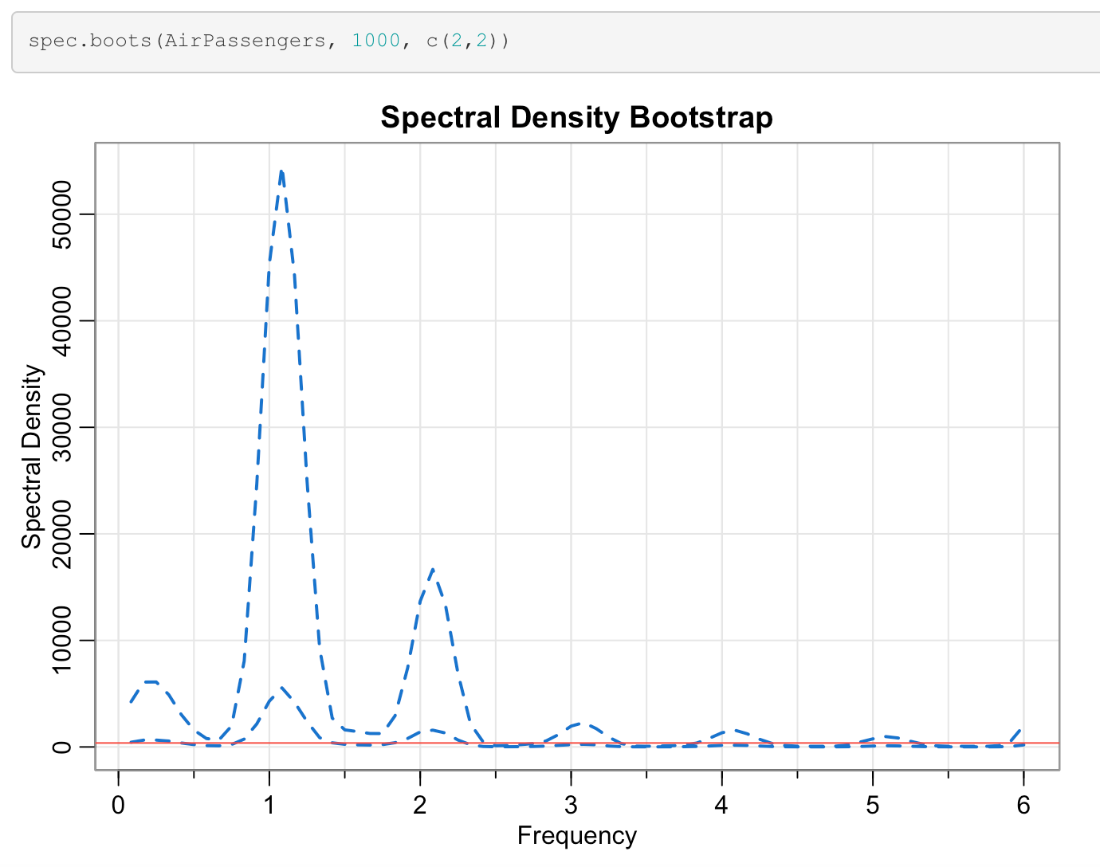
Kernel Choice Matters
Drawback of Averaging

Slide 23
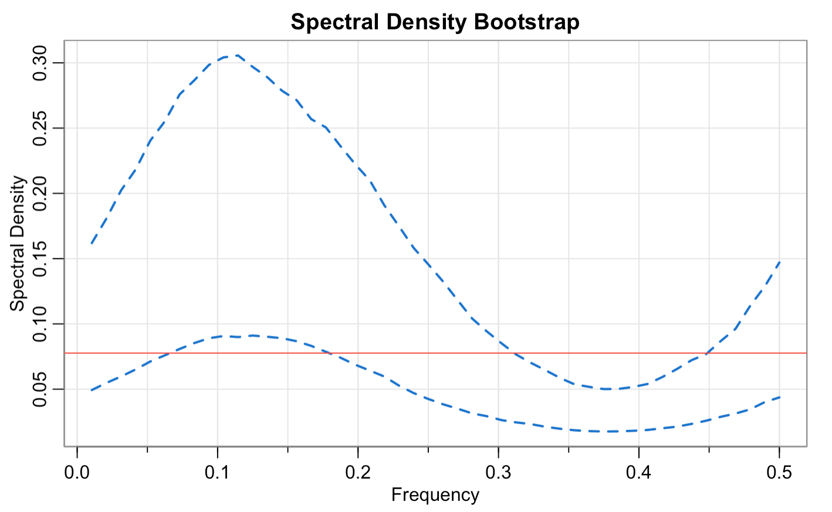
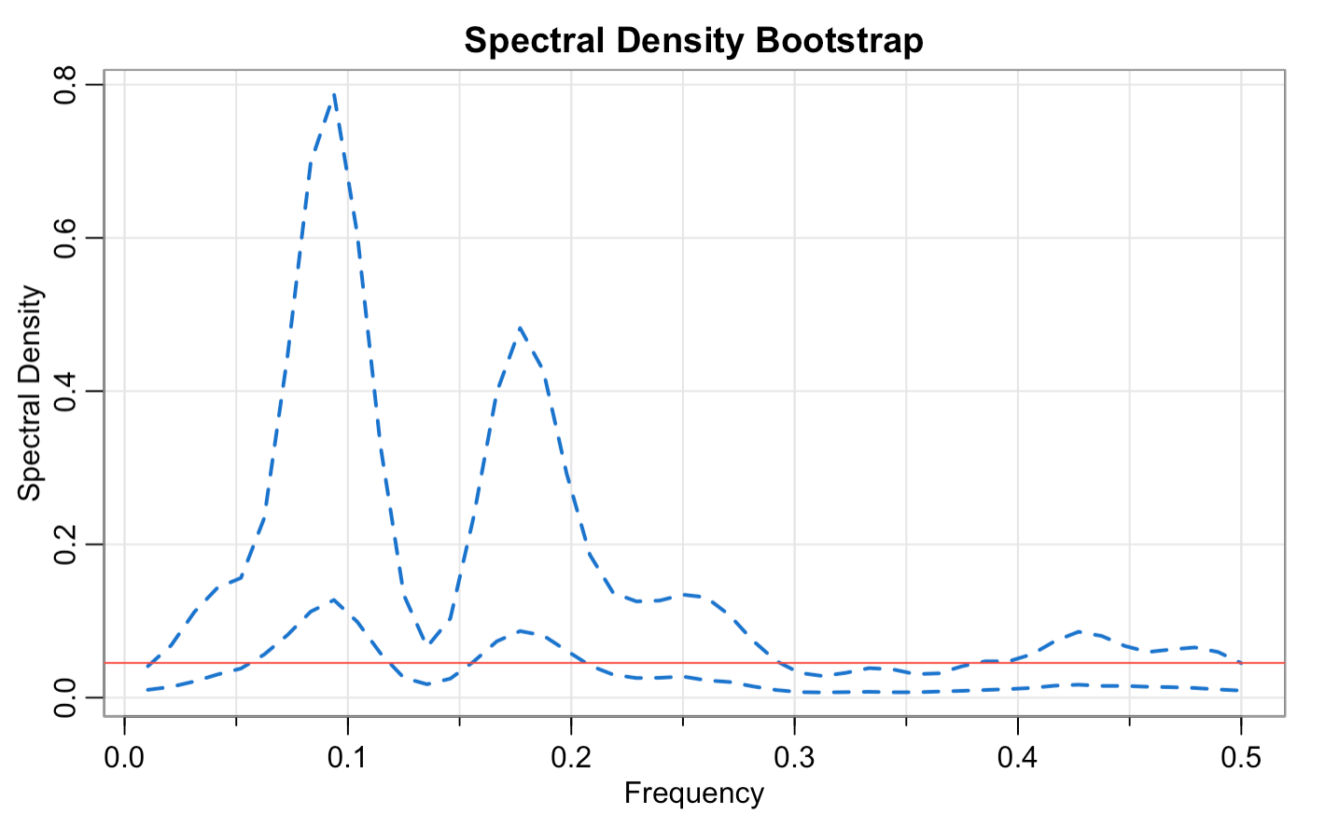
CPI returns

Slide 24
Future Work
Tapered Block Bootstrap
Autoregressive-aided Periodogram Bootstrap
Bootstrap for Threshold Models

Slide 25
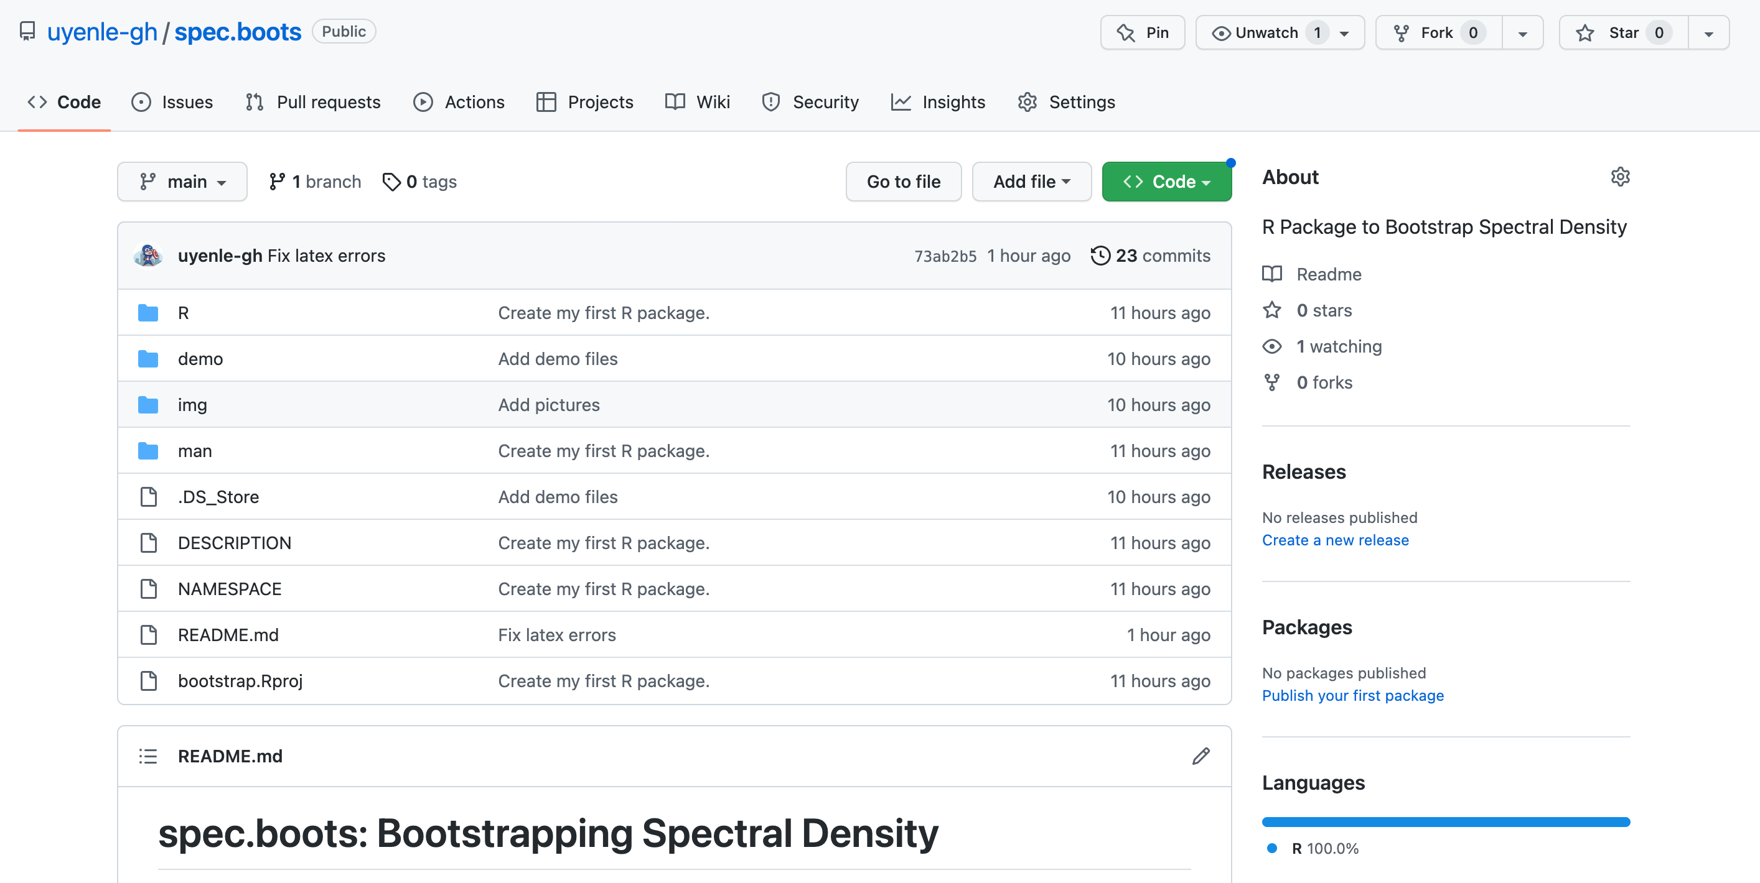
https://github.com/uyenle-gh/spec.boots

Slide 26
References
[1] Franke, J., and W. Hardle. “On Bootstrapping Kernel Spectral Estimates.” The Annals of Statistics, vol. 20, no. 1, 1992, pp. 121–45. JSTOR, http://www.jstor.org/stable/2242153.
[2] “tsbootstrap: Generate time-series bootstrap replicates.” resamplr: Resampling Methods. R Documentation. https://rdrr.io/github/jrnold/resamplr/man/tsbootstrap.html.
[3] Stoffer, David and Poison, Nicky. “mvspec: Univariate and Multivariate Spectral Estimation.”. astsa: Applied Statistical Time Series Analysis. R Documentation. 2017. https://rdrr.io/cran/astsa/man/mvspec.html.
[4] Zoubir, Abdelhak M.. “Bootstrapping spectra: Methods, comparisons and application to knock data”. Signal Process. 90, 5. May, 2010, 1424–1435. https://doi.org/10.1016/j.sigpro.2009.11.030.

Slide 27

Thank you for your listening!

